Slide 1



Slide 2
Technology Training

Slide 3
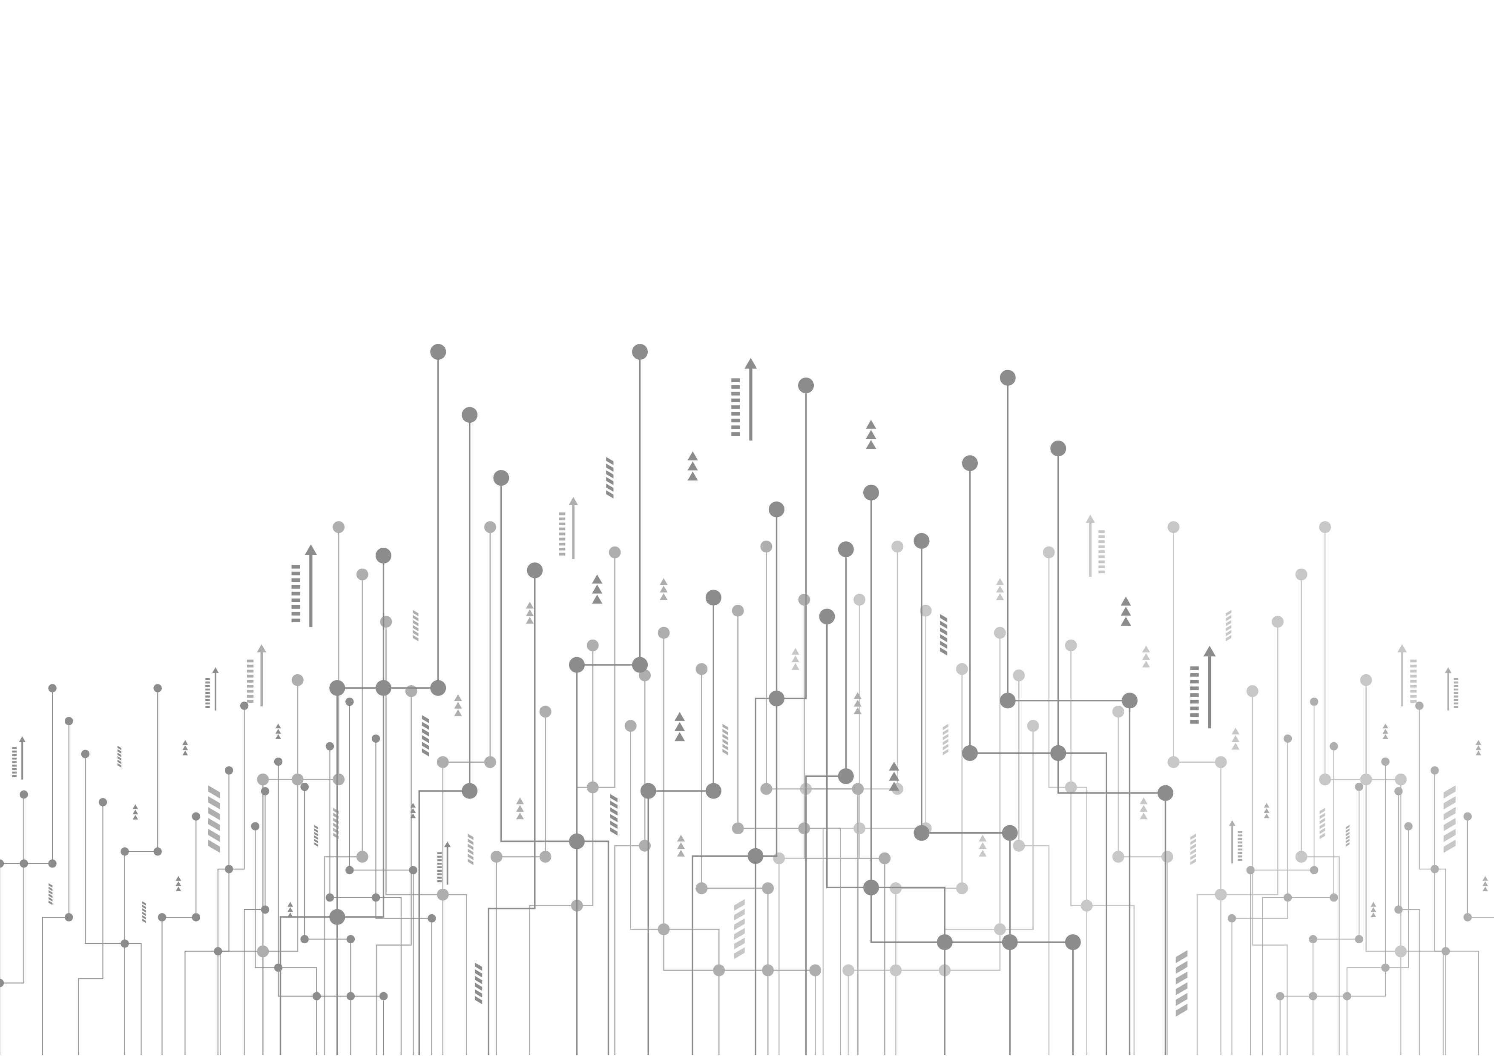
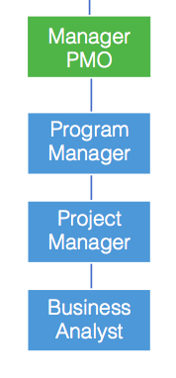
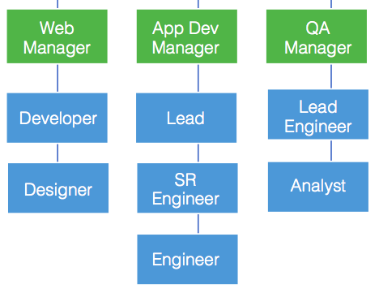
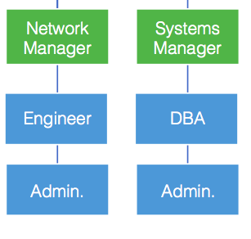
Tech Skillsets we focus on:
Development
Architects
BI & Analytics
DevOps
Team Leads
Developers
QA
Functional
Program Manager
Project Manager
Business Analyst
Product Owner
Project Coordinator
Infrastructure
Security Architects
Network & Sys Engineers
Network & Sys Admins
Information Security
Data Warehousing
SOC/NOC

Slide 4
2 Main Sides of Technology
Infrastructure / Hardware
  Computers, Networks, Storage
  Build, Maintain, Manage
  Servers
  Database i.e. storage and backup
  Network Equipment
  Desktop and Laptops
  Email & Phones
  This is what is moving to the “cloud” or “virtual”
Software (SDLC)
  Application Dev vs System Dev
    App Dev
    Web Dev
    Mobile Dev
    Cloud

Slide 5

What is the SDLC or Software Development Lifecycle?
SDLC is a process that produces software with the highest quality and lowest cost in the shortest time
SDLC includes a detailed plan for how to develop, alter, maintain, and replace a software system
SDLC involves several distinct stages, including planning, design, building, testing, deployment and maintenance.
Popular SDLC models include Waterfall, Agile & SCRUM

Slide 6
Planning: Identifying a need, consideration of solution options, and possibly considering the features of competing applications.
Analysis: Documenting the functional requirements for the application and anticipating potential problems that may be encountered.
Design: Defining how the app will work and what features and components it will have.
Implementation / Construction: This is where the actual programming occurs using the requirements and design as a guideline.
Testing / Integration: Try out the application, looking for errors and confirming that documented requirements are met. Then making the application available for people to use.
Maintenance / Support: Monitor user experience. Sometimes recommendations for revisions arise. If those recommendations are pursued, they will go through the lifecycle also.

Slide 7

What are common Methodologies within the SDLC?
Waterfall means a linear approach to development.
This is a sequential model where software development is segregated into a sequence of pre -defined phases – including feasibility, planning, design, build, test, production, and support.
The Agile model provides continuous iteration of development and testing in the software development process.
In this methodology, development and testing activities are concurrent (unlike in Waterfall). Agile allows more communication between developers, managers, testers, and customers.
  Typically handling “Sprints” of 2-4 weeks

Slide 8
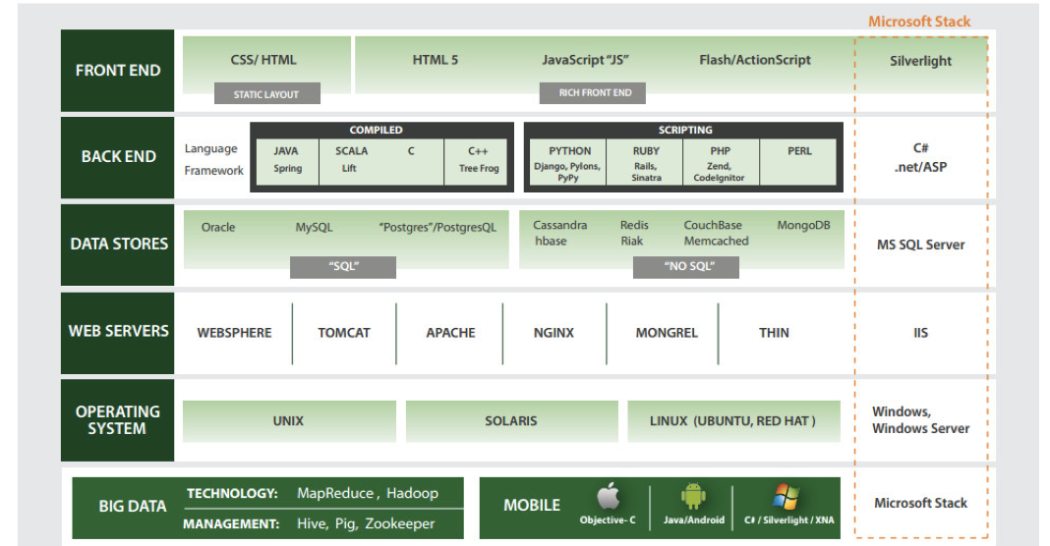
Types of Software Development / Engineering
Front-End Engineer
  “Client-Side Developer”
Back-End Engineer
  “Server-Side Developer”
Application Engineer
  Full Stack Engineer
Mobile Developer
  “App Development”
Software Engineer in Test (QA Engineer)
DevOps Engineer
Security Engineer

Slide 9
Front-End Developer / Web Developer
A software engineer who specializes in the development of the user interface (UI) is called a front-end engineer. The user interfaces include visual elements like layouts and aesthetics.
Front-end engineers deal with cross browser capability and fixing bugs to ensure an excellent visual presentation of the UI. Thus, they work with the code that runs on different user devices, browsers, and operating systems. Developing a responsive application also comes under this.
What you need to know: HTML, JavaScript, Django, C/C++, ASP.NET, PHP, Python, Ruby, Rails etc.

Slide 10
Back-End Developer
The back-end, or “server side”, of a website is where the data is stored and it usually consists of three parts: a server, an application, and a database.
Back-end developers need to understand databases, as well as server programming languages and architecture. If an application keeps crashing or is mind-numbingly slow or keeps throwing errors at you, it’s likely to be a back-end issue.
Finally, database management is a prime aspect of back-end development. Database management is the backbone of any system that holds large amounts of data. Think companies’ client database, such as Facebook’s; one billion users’ details have to be organized somehow, and back-end developers make this their job.
What you need to know: Python, Java, C and C++, (my)SQL, dBase and Oracle for databases

Slide 11
Application Development / Full-Stack Engineer
This is the “original” type of programming. These are ‘standard’ applications that perform their duties on traditional desktop operating systems, such as Windows, Mac, or Linux.
It’s often considered a program, executed on demand by the user, that opens its interface in the confines of the OS that it’s running in.
Application development is basically the process of creating a computer program or set of programs that can assist the daily functionalities of the user or business.
What you need to know: Java, .NET, C/C++, C#, Python.

Slide 12
Mobile Developer / App Developer
Mobile Development could better be described as “App Development” and involves creating applications that run on mobile devices, such as iPhones, Android devices, and recently, the Windows 10 platform.
Most popular OS’s are built with their own programming languages but some traditional languages are being used as well.
The versatility of mobile development allows anything from Candy Crush, to console-like quality games in the palm of your hand. Games aren’t the only thing to focus on either; there are all sorts of apps for pretty much anything : YouTube, Instagram, Snapchat, TikTok ect…
What you need to know: Android, Swift (for iOS), Objective C, HTML5, Java, C#

Slide 13
QA Engineer / SET / SDET
A “Software Engineer in Test” (a.k.a. “Software Development Engineer in Test”) is a software developer who develops software for testing: tools, frameworks, and automated tests.
SETs focus primarily on automation for running tests quickly and repeatedly. Test automation is a software product: just as front-end developers write web pages and back-end developers write microservices, SETs write automated tests. The same practices and coding skills apply.
Tech giants like Microsoft and Google employ software dev’s by the bucketload to design applications for testing other projects on-the-go.
What you need to know: Java, Python, C++

Slide 14
DevOps Engineer
DevOps is a software development strategy which bridges the gap between the developers and the IT staff. With DevOps, organizations can release small features very quickly and incorporate the feedback which they receive, very quickly.
DevOps process involves a lot of development, testing and deployment technologies for developing automated CI/ CD pipelines. Following are some of the famous DevOps tools:
  Git and GitHub – Source code management (Version Control System)
  Jenkins – Automation server, with plugins built for developing CI/ CD pipelines
  Selenium – Automation testing
  Docker – Software Containerization Platform
  Kubernetes – Container Orchestration tool
  Puppet – Configuration Management and Deployment
  Chef – Configuration Management and Deployment
  Ansible – Configuration Management and Deployment
  Nagios – Continuous Monitoring

Slide 15
Security Engineer
A security engineer is tasked with the monumental role of protecting the networks and computer systems of a company from any security threats or attacks. Mostly, a security engineer is responsible for establishing and implementing security solutions that can defend a company and its networking assets.
*The TV show Mr. Robot
Otherwise known as “hacking”. Penetration testers (“white-hat” ethical hackers) and cyber-security experts work together for the good of companies and their systems and data.
The cyber-security team develops software to keep important company assets safe from theft, viruses and other malicious attacks. The pentester, or penetration tester, then tries to ‘hack’ into the system to find where the vulnerabilities, or weak spots, are. This way, there’s less chance of your “black-hat” actual malicious hacker getting into your important data.

Slide 16
Now that we know more about what they do, how do we recruit developers?
Key’s to remember:
  Titles are not everything
  Always consider their functional responsibility
  Get creative with your searching / sourcing
  According to an Indeed survey almost 9 in 10 respondents (86%) said they find it challenging to find and hire technical talent.
  The U.S Bureau of Labor Statistics has projected that by 2020 in the US alone there will be over one million computer science-based jobs without qualified college graduates to fill them.
  The current tech unemployment rate in the US is close to 1%
  For the past nine years, software engineers have been at the top of hardest to fill jobs in the United States.

