Slide 1

Data Modernization

Slide 2
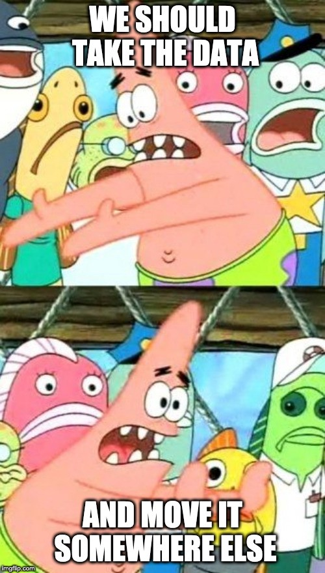


Data Basics
Companies drive their decisions based on data.
Relatively new in the IT space.
92% of Fortune 1000 companies are increasing big data investments.
End goal - gain insights on market trends and increase revenue.
Emerging space to bridge the gap between IT and marketing.

Slide 3
Data Job Titles / Breakdown
Analytics
Data Transformation
Data Science
Data Analyst
Data Architect
Data Scientist
BI Developer
Data Engineer
Machine Learning Engineer
Report Developer
ETL Developer
Data Specialist
Database Engineer
MLOps Engineer
Database Administrator
AI Specialist
Notes:
Data Architect – build out entire business intelligence framework.
Data Engineer – build pipelines to move data and transform data.
Database Administrator – maintain and update the physical database, keep it secure.
Tableau Developer – develop visualizations utilizing Tableau.
Power BI Developer – develop visualizations utilizing Power BI.
Data Analyst – assist in moving data throughout the organization, typically more entry level.

Slide 4
Data Transformation
Common Tools & Technologies:
Scripting Languages:
  Python, Scala, Java, SQL
Cloud
  AWS, GCP, Azure
  ETL
    Talend, SSIS, Informatica
  Data Warehouse:
    PostgreSQL, Amazon S3, Redshift, Snowflake
Data Engineer
Data Architect
ETL/ELT – extracting, transforming, loading the data.
Responsible for cleaning the data.
Build pipelines that transport and transform data.
Ensures that the data is in a highly useable state by the time it gets to the end users.
A data architect designs and manages data systems, sets policies for how data is stored and accessed, coordinates various data sources within an organization, and integrates new data technologies into existing IT infrastructures.
Typical Salaries:
Engineers: $130-$190k
Architects: $160 – $200k

Slide 5
Data Transformation
**Keep the lights on**
Ensure databases run efficiently and smoothly.
Two main types in use:
Microsoft SQL Server
Oracle
Development Database Administrators
Support Database Administrators
Sometimes called “database engineers”
Use specialized software to build out entire databases
Perform general maintenance and updates
Usually have an on-call schedule
Typical Salaries:
Engineer: $130k - $150k
Administrator: $90k - $130k

Slide 6
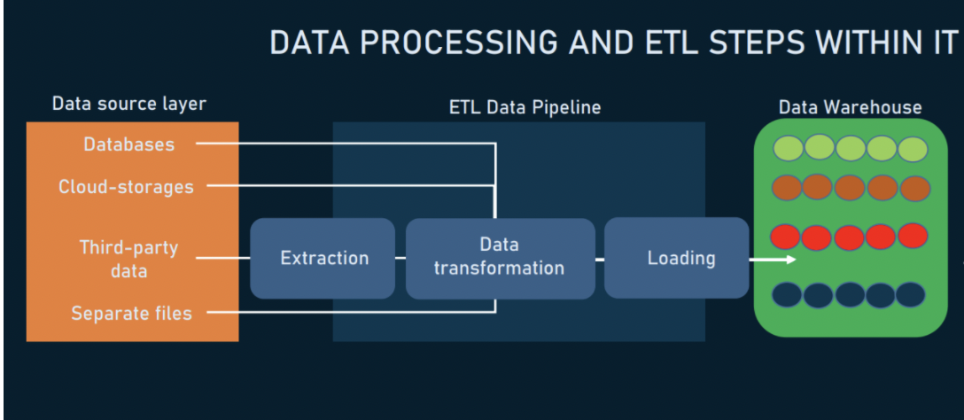
Data Transformation
House analogy

Slide 7
Questions to ask for Data Transformation
Data Architect
Data Engineer
Database Administrator
What % of your day is actual design work versus people management?
How much interaction do you have with the business?
What % of your time do you spend hands on scripting?
Where environment do you work in? (on prem or in the cloud)
Have you worked on a migration from start to finish?
What programming languages do you work with?
Are you building pipelines from scratch or modifying existing built out pipelines?
Do you participate in an on-call schedule?
Have you worked on a migration from start to finish?
How much development work are you doing versus support work?

Slide 8
Analytics
Common Tools:
Power BI
Tableau
SAS
Excel
QlikView
SSRS
SQL
Excel
Data Analyst
BI Developer
Develops visualizations that tell stories with the data.
Works collaboratively with end users to develop reporting systems that provide accessible information for decision-making.
Uses warehouse data to solve organizational problems through reports, analysis and data visualization.
Work with data to help their organizations make better business decisions.
Draw conclusions from data to describe, predict, and improve business performance.
Form the core of any analytics team and tend to be generalists versed in the methods of mathematical and statistical analysis.
Typical Salaries:
Senior: $120k - $150k
Mid: $100 - $120k
Junior-Mid: $80k-$100k

Slide 9
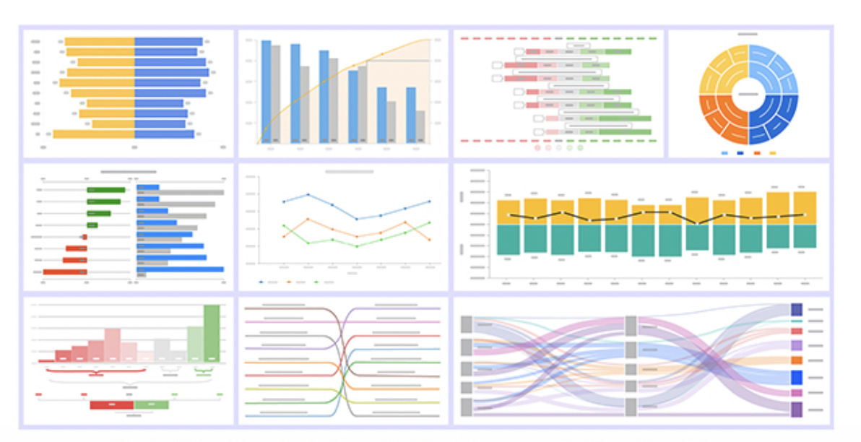
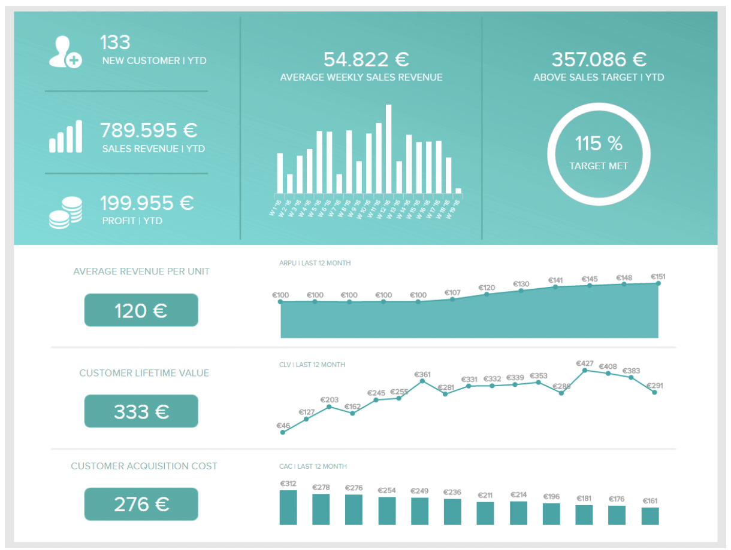
Questions to ask for Analytics
Example dashboards
BI Developer
Are you building new dashboards or modifying existing dashboards?
Do you present your own dashboards?
How much work are you doing daily with SQL?
What is your team structure?
Who is your audience? (Internal or external)
Data Analyst
Are you using SQL to write queries from scratch?
Where do you pull your data from?
What is your team structure?
Who are you working with / communicating directly with?

Slide 10
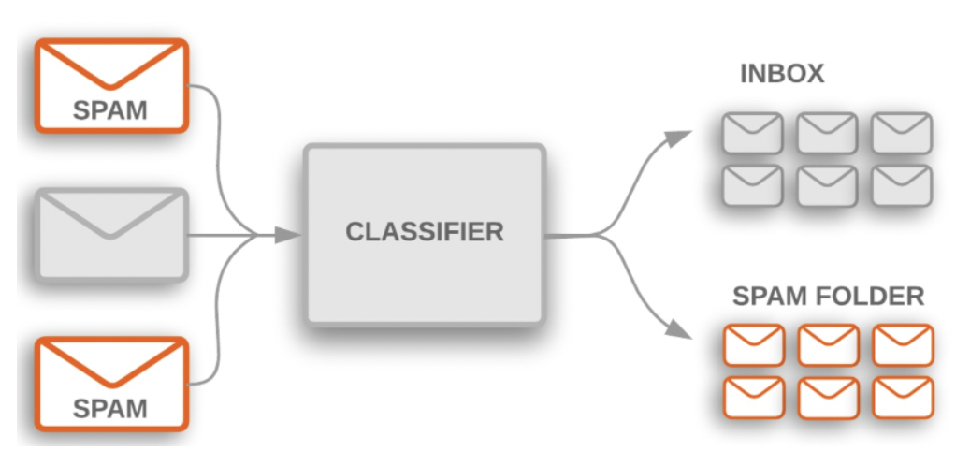


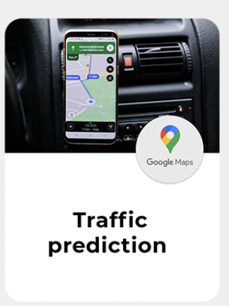

Data Science
Data Scientist
An interdisciplinary field that uses scientific methods, processes, algorithms and systems to extract knowledge and insights from noisy, structured and unstructured data, and apply knowledge and actionable insights from data across a broad range of application domains.
Common Tools:
Scripting Languages:
  Python, SAS, R
  Machine Learning
  Artificial Intelligence
  Natural Language Processing
  Computer Vision
  Deep Learning
    Keras, PyTorch, TensorFlow
Typical Salaries:
Senior: 175k - $220k
Mid: $130 - $175k
Junior: $95k-$130k

Slide 11
Questions to ask for Data Science
What business problems are you applying data science methods to?
What programming languages do you utilize? (If they touch on Python ask if they work with the entire Python library (Pandas, Keras, NumPy)).
What tools do you use for deep learning (PyTorch, TensorFlow, H2O)?
What cloud environments have you worked in?
Do you have any experience with computer vision? (People who work in automotive, health care, or energy industries will typically have this)
How closely do you work with the business?
Do you have a particular area of expertise in data science? such as NLP, Optimization, etc.?
What is your team structure?

Slide 12

Data Science and Analytics
Untouched data
Cleaning
Visualization
Data scientist
Data Analyst
Data Analyst = people
Data Scientist = machines

Slide 13
Common Tools and Terms
ETL / ELT (Process Data Engineers use to move the data from one place to another.)
Cloud – wave of the future, moving away from on-premise databases and moving towards cloud databases.
  Azure
  Amazon Web Services
  Google Cloud Platform
  Databases:
    SQL Server
    Oracle
    MongoDB
    DynamoDB
    Redis
    PostgreSQL
Programming Languages:
Python
Java
Scala
SQL
R
SAS
Visualization Tools:
Power BI
Tableau
Looker
Big Data Terms:
Spark
Hadoop

Slide 14
Things to look for:
Prescreens:
Worked with newer cloud technologies.
Being able to automate processes with Python, R, or other scripting languages.
Able to describe their projects, and the end goals of their business intelligence projects.
LinkedIn Profiles:
Referrals.
How active they are on linkedin.
How many connections they have.
Resumes:
Good tenure (stayed with previous companies for over two years)
Resumes are no more than 3 pages long
Caution: look out for people who have listed every single skill known to man (They’re not that good)

Slide 15
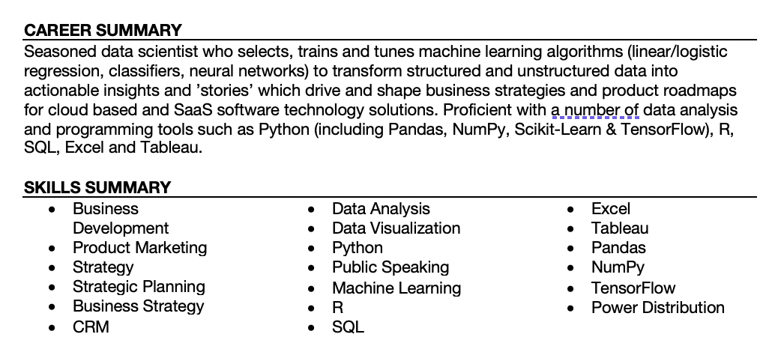
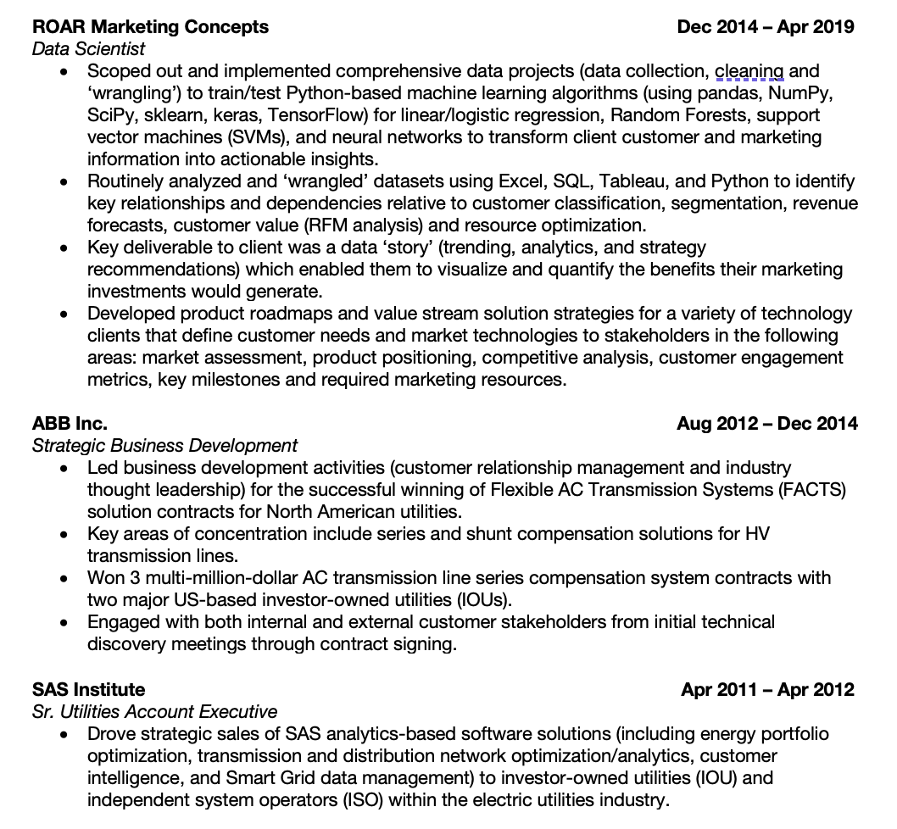
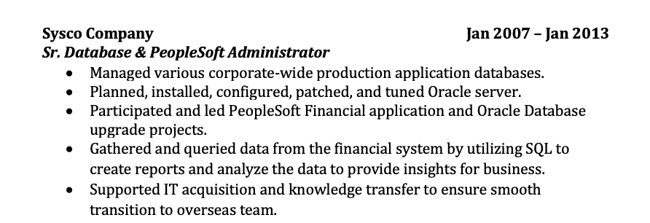
Good Resume

Slide 16
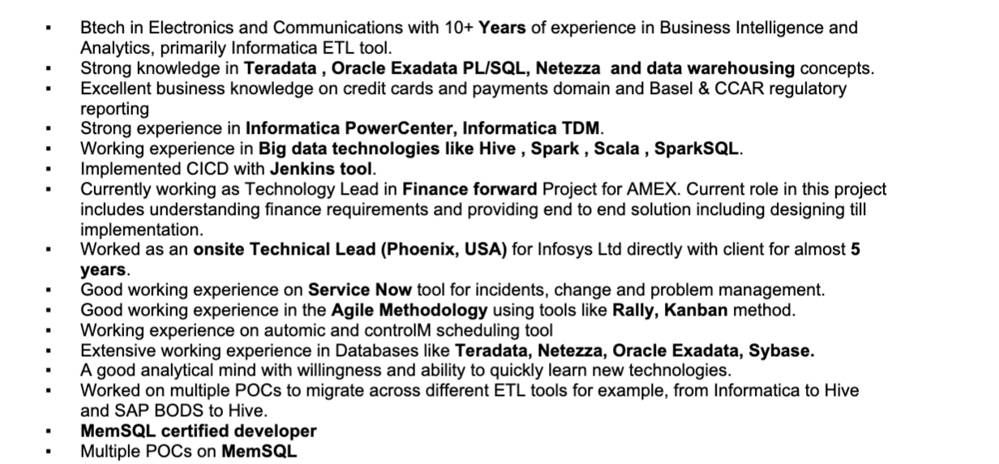
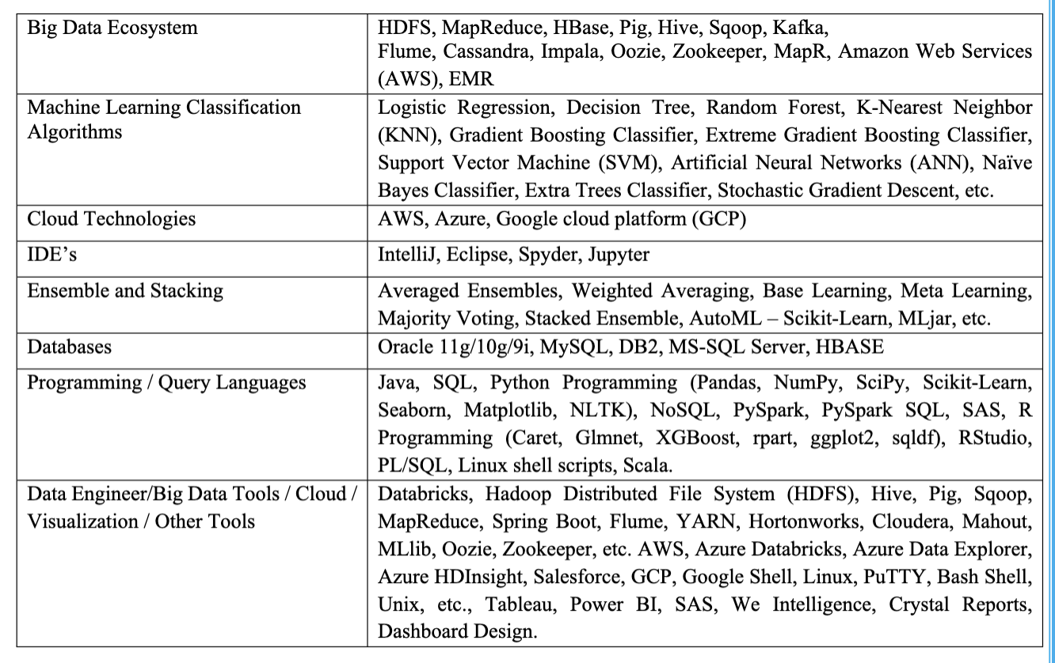
Proceed with caution

Slide 17
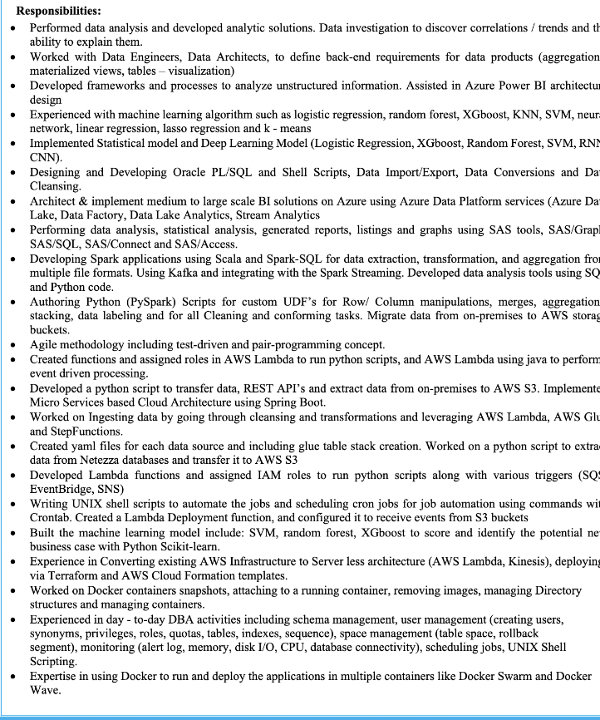
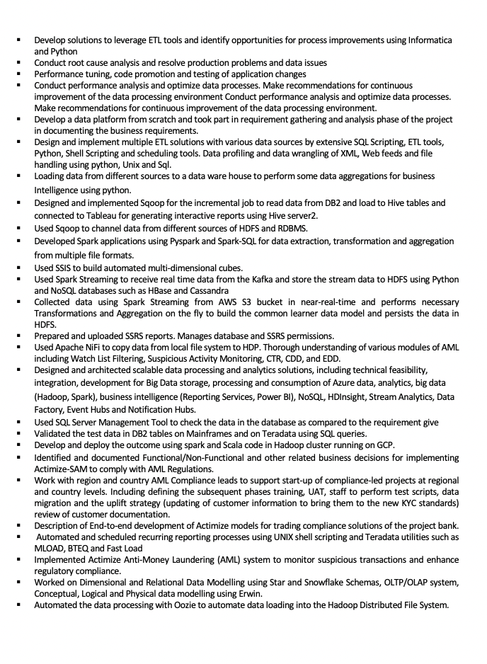

Slide 18













Clients that bring in the most business

Slide 19
Questions?

